Slide 1
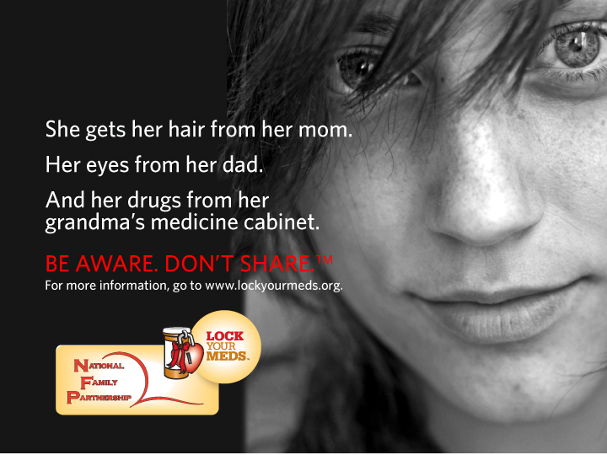
Notes:
This slide should be visible as people are entering room to see the presentation. It allows the “look and feel” to sink in.

Slide 2

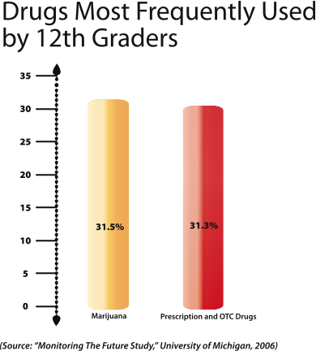
Prescription Drug Abuse
Alarming Trends
400% increase in 10 years.
Exceeds all other illicit drugs combined, except marijuana, which it matches.
4,000 children/young adults begin experimenting per day.
Teen admissions to treatment facilities for addiction up 300% since mid 1990s.
Notes:
Prescription medications taken properly help heal illness, relieve pain, control disease and help bring balance to your life. But when these medications are taken by someone they were not intended for, they can be very dangerous, addictive and even lethal.
An alarming trend is emerging across the nation. Our adolescents are misusing prescription medications that were prescribed to help another. Here are some disturbing facts about prescription drug abuse:
The Substance Abuse and Mental Health Services Administration has documented that within last 10 years, there’s been 400% increase in prescription medication abuse.
Did you know that prescription medications are abused more than all illicit drugs combined, except marijuana? (National Institute of Drug Abuse, University of Michigan, Monitoring the Future Survey, 2006)
In the 2008 National Survey on Drug Use and Health, the Substance Abuse and Mental Health Services Administration also found that every day, more than 4,000 children/young adults begin experimenting with prescription & over-the-counter (OTC) medications.
The Office of National Drug Control Policy cites teen admissions to treatment facilities for addiction to prescription pain relievers is up 300% since mid 1990s (Teens and Prescription Drugs, February 2007).

Slide 3
The Problem
Misconceptions
They believe:
  It’s legal
  It’s safe
  It’s okay to combine them
    “Pharm or rainbow parties”
Notes:
There is a real problem in what teens think when it comes to using prescription medications. Many teens and young adults share misconceptions about prescription medications that can result in an overdose, addiction and even death.
Teens believe:
Prescription medications provide a legal and “medically safe high.” After all, a doctor did write the script. What teens don’t realize is that doctor prescribed the meds based on that patient’s age, weight, condition, etc. The doctor can monitor the patient’s reaction/dosage/progression on the meds. But, when teens take someone else’s medicine, there is not a doctor there to monitor what happens.
Over-the-Counter medications are administered by parents/adults so they must be safe for use whenever. Adolescents think these OTC medicines are less addictive and dangerous than street drugs so it can’t hurt. Not true. The dangers are just as severe, and teens need to know that.
If that isn’t enough, teens often combine prescription or over-the-counter medicines with other substances like alcohol or marijuana.
Teens are attending “pharm or rainbow parties” where various prescription medications are dumped into a bowl or spread out on a table and randomly ingested. Most likely they are ingested with the alcohol supplied at the very same party.

Slide 4
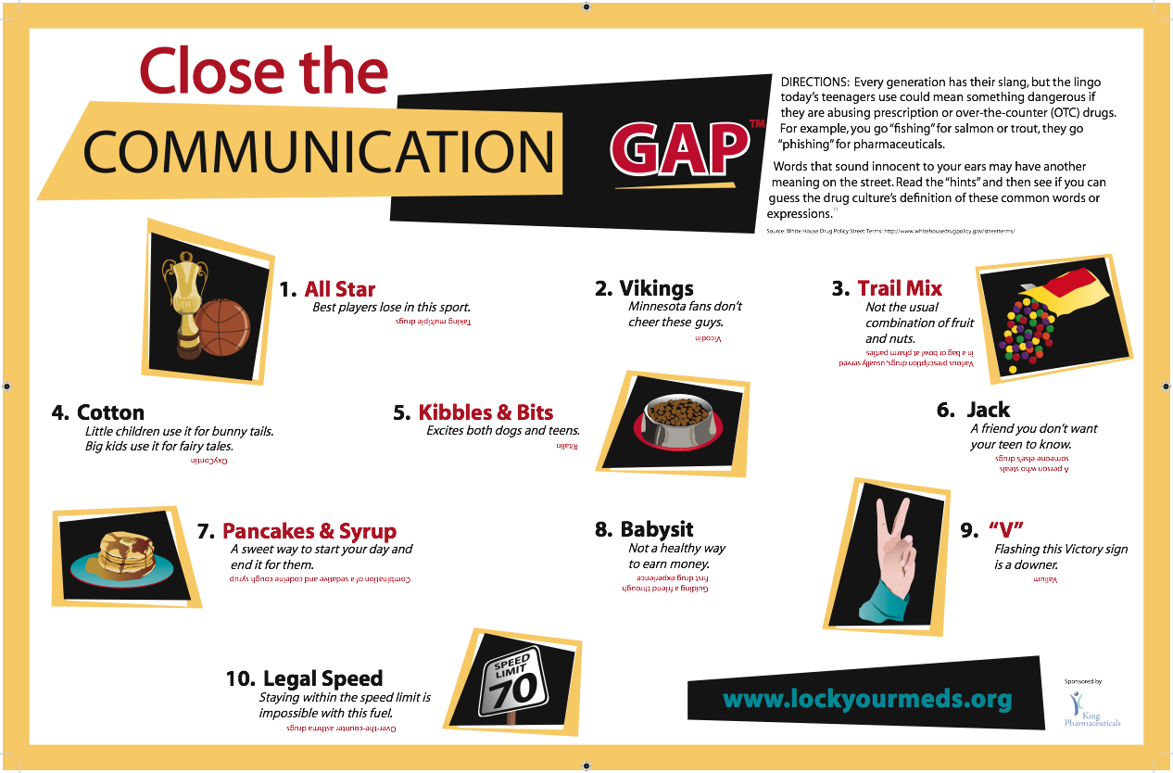
The Problem
Miscommunication
Notes:
Optional slide depending on time limits.
There is a big problem with miscommunication between parents or grandparents and their children. (Click on slide to bring up Communications Gap.) Teens use lingo that could be describing drug use. It may sound innocent to you, but have a very dangerous meaning.
Can you identify which commonly abused drug is described in these terms used by our teens?
(Take them through some of the terms as time permits, or use the Communications Gap as a handout.)

Slide 5
WHY?
Funnier
Escape
Relief
Prettier
Fit in
Notes:
Many of you may be sitting there trying to understand why a young person would abuse prescription medication. (click on slide to start animation with words coming on screen.) Teens give many reasons, some of which include:
To appear funnier than they are
To escape reality of day-to-day stresses, usually caused by family issues
To find some relief from their depression or anxiety
To appear prettier or more attractive or less weight.
To “fit in” with friends who are using
To cope with the stressors of life

Slide 6
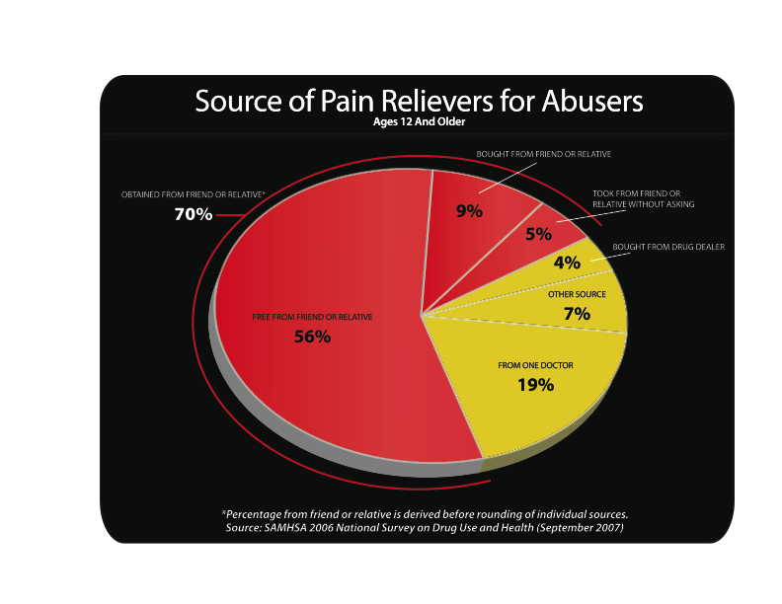
The Suppliers
It’s Us
70%
of people over 12 who abuse prescription drugs get them from family or friends.
Notes:
Today's news headlines are filled with stories about "pill mills" and "doc shopping," and while they are real problems, they are not the primary suppliers. Neither are typical drug dealers on the street.
So where do they get it, and what exactly is “it?” It is the typical pharmacy drug found in average household medicine cabinets across the United States. That means that the person who is subscribed the medication has become the supplier and does not even realize it. That means, it’s you and me, parents and grandparents, friends and family.
The Substance Abuse and Mental Health Services Administration reported in the National Survey on Drug Use and Health (2008) that 70 percent of the abused drugs come from friends and families. Naturally, adults keep their prescription medications accessible so they have it when they need it – in the bathroom, on the nightstand, on the kitchen counter, in her purse. But what adults don’t realize is these medications are now handy for teens to take. Parents and grandparents, the "unwitting suppliers," must be made aware and not share their medications.

Slide 7
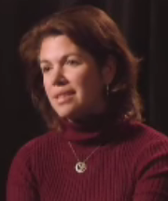
The Solution
Awareness
If we make people aware,
they won’t share.
Michelle Lupinski, Principal
North Shore Recovery High School
“I think it’s very, very important
that we educate people – at every level.
It’s nobody’s fault. We just have to address it.”
Notes:
What’s the solution? What can we do to help combat this problem? The solution is Awareness. Simply put, if we make people aware, they won’t share.
Michelle Lupinski is the principal at North Shore Recovery High School in Beverly, Massachusetts. A teacher for over 12 years, Ms. Lupinski witnessed too many children struggling with substance abuse issues, overdoses and went to too many funerals. She began an alternative education program in a larger high school to address these issues. It wasn’t until her superintendent disclosed to her his own experience with his child who suffered from an drug addiction to oxycotin, which later progressed to heroin, did something get done. Together they started North Shore Recovery High School.
No more shoving the issue of prescription drug abuse and addiction under the rug. In her words:
“I think it’s very, very important that we educate the community, the people who are prescribing, educators, family members about how important it is that we address this issue – at every level. It’s nobody’s fault. We just have to address it.”

Slide 8
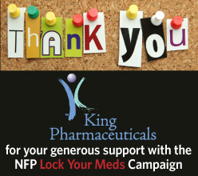
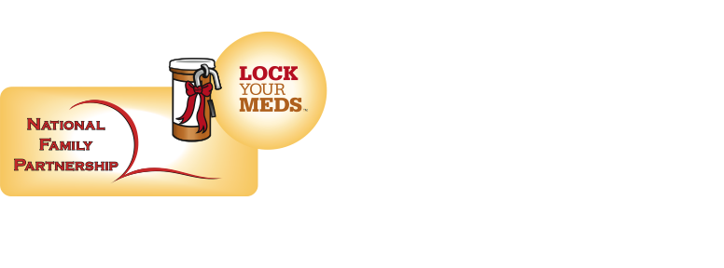
The Solution
Lock Your Meds™
National campaign created by National Family Partnership (NFP)
  Create awareness to “unwitting suppliers”
Powerful messages, using traditional and new social marketing venues
Notes:
National Family Partnership is offering a solution to this growing epidemic. This new initiative, Lock Your Meds, is all about awareness.
National Family Partnership is a growing network of local coalitions, government agencies, education and parent groups who work to improve the lives of families at the grassroots level. NFP provides a national voice and valuable resources to these groups.
Lock Your Meds ™ is a national, multi-media campaign designed to reduce prescription drug abuse by making adults aware that they are the "unwitting suppliers" of prescription medications being used in unintended ways, especially by young people.
The initiative is a call to action for all parents to take a stand against the alarming increase in prescription drug abuse. When armed with appropriate information and tools, parents and grandparents can become our Number One line of defense against this dangerous epidemic.
And we couldn’t do this without the tremendous support we receive from King Pharmaceuticals. They bring financial and human resources to our campaign, as well as a wealth of expertise about prescription drug abuse.

Slide 9
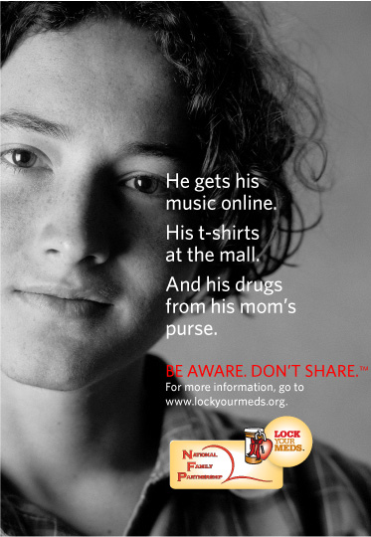
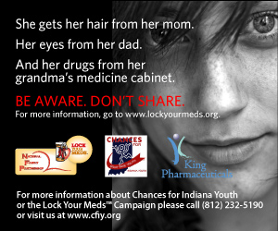
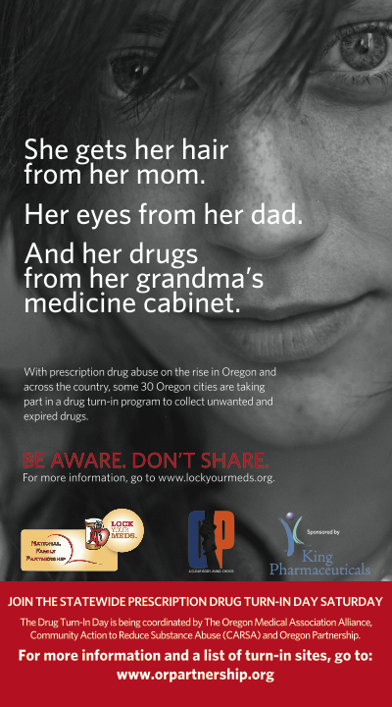
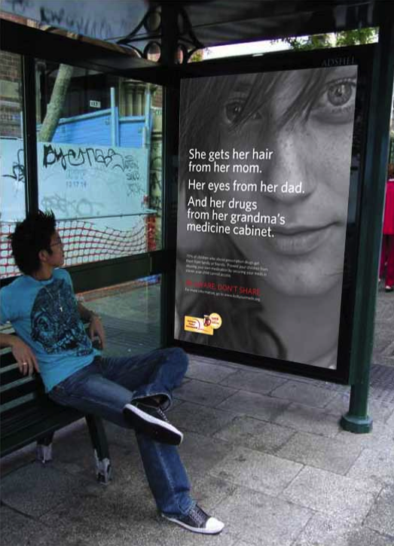
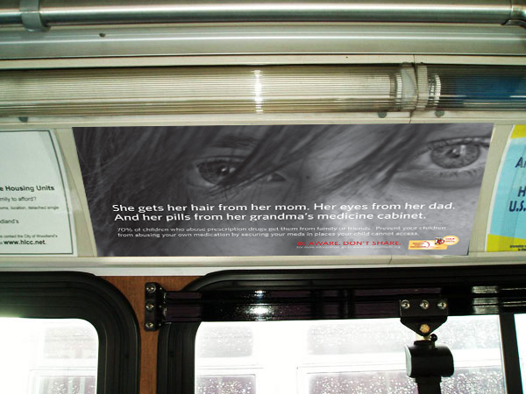
The Solution
Lock Your Meds
A multi-media approach for message delivery
  Radio
  TV
  Print
    Publication ads
    Web ads
    Posters
    Bus shelter ads
    Transit ads
  Billboards
Notes:
Lock Your Meds uses a multi-media approach to deliver it’s message to adults. Such media includes:
Radio
TV – which you saw at the beginning of this presentation
Print – which includes:
Newspaper and magazine ads, like this one.
<Click once and talk as images appear 5 seconds apart>
Web ads, like this one, which are customized to the local affiliate or event.
Posters, which can be localized, like this one is for the Oregon Partnership Drug Take-back Day
Bus Shelter Ads, which people can read while they’re waiting for a bus.
Transit Ads…or while they are riding the bus, like this one.
Billboards

Slide 10
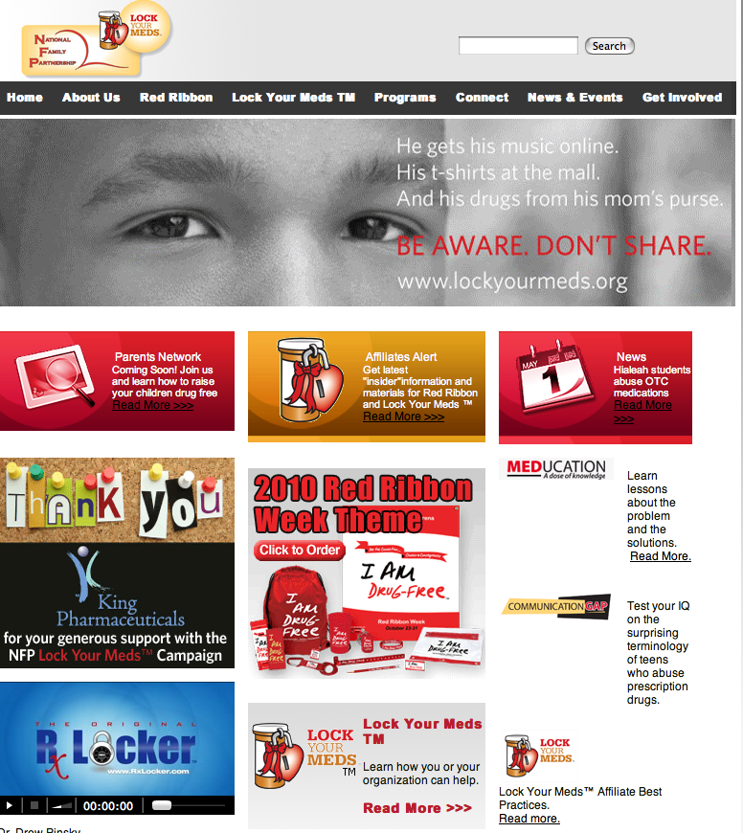
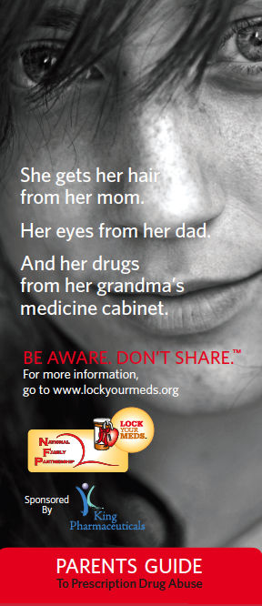
The Solution
Lock Your Meds
A multi-media approach for message delivery
  Parent Guide
  Media Kit
  Outreach, events
  Web
    www.lockyourmeds.org
    Web ads
    Links to partners, supporters, sources
    Parent Network
Leveraging the power of one brand
throughout entire NFP network
Notes:
Media Kit
This kit has been sent to media outlets nationwide, and includes press releases, parent guide, MEDucation Guide and more.
Outreach and Events
Internet (click to bring up website or “go live” to the website to show them.)
Log on to www.lockyourmeds.org for resources, materials and more
Web ads
Links to other partner and supporter organizations

Slide 11
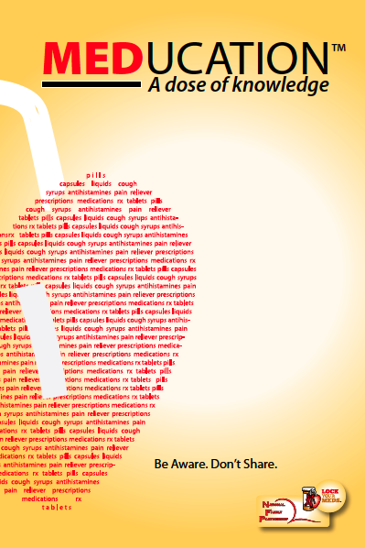
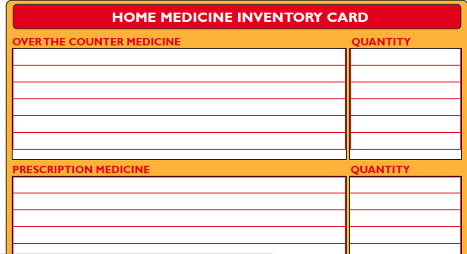
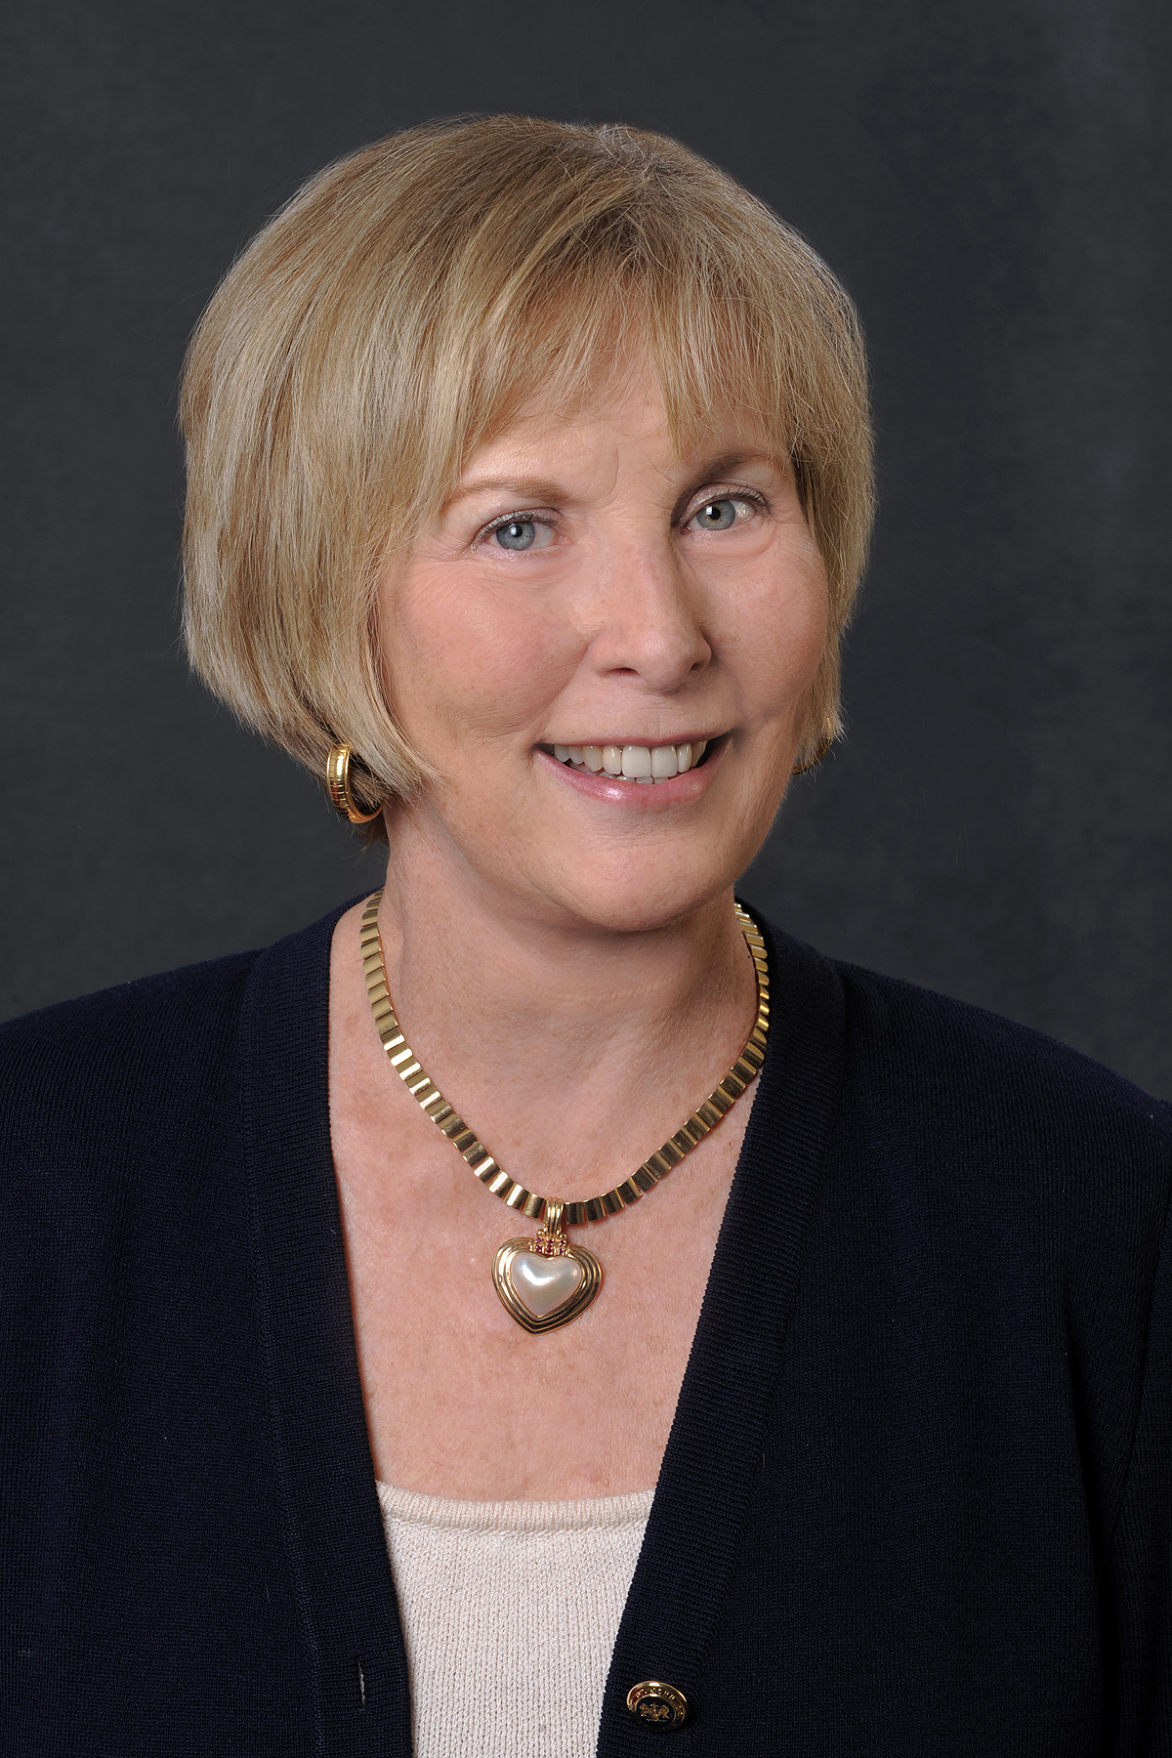
Everyone Can Help
What To Do
Lock Your Meds
Take Inventory
Educate Yourself
  MEDucation
Talk to your children
  Set clear rules
Properly dispose
“Be aware and don't share your medications.”
-- Peggy Sapp, NFP President
Notes:
As Peggy Sapp, NFP President, says, “Be aware and don’t share your medications.” But how? What steps should be taken? The Lock Your Meds initiative helps parents and grandparents know what to do to combat this issue.
Lock Your Meds. Store your medications in a location where children cannot access them. This includes all over-the-counter medications as well.
Take inventory of your medications. The campaign provides a Home Inventory Card in the “Parents Guide.” This is a very helpful chart. As you can see, it provides you a place to list the medication and the quantity. This is set-up to be done on a monthly basis.
(click on slide to bring up MEDucation Guide). Educate Yourself. Families can gather information about the extent of the problem by reading the "MEDucation Guide.“ This guide can be used for a variety of functions:
Talking points for speech
• Handout at events (all or pages)
• Create skits, plays, games, humor
• Tabletop for doctor offices, clinics
• Distribute at pharmacies, stores
• Hand out at nursing homes
Talk to your children. Set clear rules, such as no sharing of medications with anyone and always follow proper dosage instructions.
Properly dispose. Educate yourself on the proper way to dispose of old, expired or unused medicines. Local law enforcement offices offer “take back” collection sites. Check with your local authorities for more information.

Slide 12
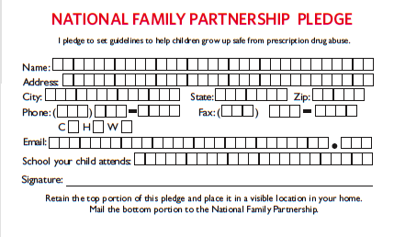
Everyone Can Help
Take the Pledge
Pledge to protect your children and grandchildren and help us spread the word.
Lockyourmeds.org
Notes:
Everyone can help fight the growing trend of prescription drug misuse. The National Family Partnership works with affiliates, schools and health care professionals across the nation, touching millions through many different mediums. With the help of these organizations, we can reach parents and grandparents and give them a voice in this fight.
Parents and grandparents can take a stand against prescription drug abuse by signing a pledge card. This pledge declares their commitment as parents to share this knowledge and the preventative steps that are key to ensuring a drug-free future for their children and grandchildren.
Just go to lockyourmeds.org to find out how.

Slide 13
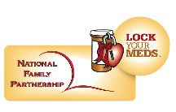
Join Our Campaign
Tanya Byng, Project Manager
(800) 705-8997
(305) 856-4886
tbyng@nfp.org
Notes:
Prescription drug abuse is rising at an alarming rate. Our young children and teens are embarking on a journey that is very dangerous, possibly ending in death.
This problem is a result of teen misconceptions about prescription and OTC medicines and easy access to them. Even worse, these meds are being supplied by friends and family that have no idea they are doing so.
Our best line of defense is awareness. We must educate parents and grandparents on this issue and equip them for combat. Lock Your Meds is our solution for awareness and education.
Join our campaign and help further our efforts to curb prescription drug abuse. Together, if we make unwitting suppliers aware, then they won’t share.
For information on joining the campaign, contact Tanya Byng, Project Manager for Lock Your Meds.

